Slide 1
Direct Capture of Objectives
Presentation subtitle is Open Sans Regular 14pt, one line maximum
December 2017| Ashlee French, Enterprise Advisory Services Director

Slide 2
Table of Contents
Introduction to DCO
DCO Artifacts
DCO Processes

Slide 3
Introduction to DCO

Slide 4
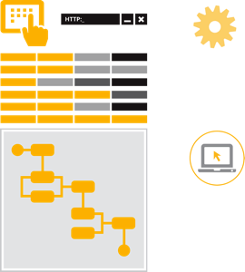
What is Direct Capture of Objectives (DCO)?
Direct Capture of Objectives - or DCO - is the process of collaboratively capturing, organizing, and storing information in Pega
DCO is used by IT, business, testing… in a collaborative way that promotes business end-user involvement
DCO saves time, effort and money
DCO improves application quality
Continuous DCO is the application of these principles in real time throughout the project
DCO can be used with any methodology
Notes:
DCO is a comprehensive set of capabilities and best practices that allow you to capture, organize and store information, which offers many benefits.
DCO is used by all project participants - IT, business, testing – to help them collaborate better.
DCO saves time, effort and money by helping create your application iteratively and increase its visibility to users throughout the implementation, thus improving our response to change.
DCO improves application quality, because what users see is what they get. In other words, since the development team is using the same tool to design and build the application, if the business likes what they see, they can be more confident that the actual application will meet their expectations. A business stakeholder can view a draft screen, suggest changes, and have those changes made right before their eyes. Doing this over and over again throughout the lifecycle of a project enhances quality as the stakeholders understand that what they see is what they get.
When do we do DCO? Anytime we enter something in Pega, we are “doing” DCO. We “do” DCO continuously throughout the project’s implementation. It isn’t a methodology or something that we do at a single point in time.
Lastly, DCO can be used regardless of methodology – it’s a set of tools and processes that can be applied to any Pega project. Any methodology can take advantage of DCO tools and techniques.

Slide 5
Direct Capture of Objectives
Features and benefits
Enhances collaboration: facilitates cross-department communication and engagement to increase agility
Traceability of application artifacts (objectives, specifications, requirements, implementation rules) provides 360° view of application
Centralizes rules and data to enable repeated reuse
Automates the work
Visual tools: no coding – your words become the software
Real-time, “as-built” documentation
Effort estimates (also known as sizing)
Executable, demonstrable flows and UI lead to increased quality

Slide 6
“Doing DCO” is Using Pega as a Repository
Executable Models
Automated Documents
Application Profile
Flows & Draft UI
Business Objectives
Traced Artifacts
DCO
Repository
Automated Effort Estimates
Stages, Cases & Steps
Require-ments
Speci-fications
Quickly Extend Strategic Application
Automated Rule Creation

Slide 7
Direct Capture of Objectives
DCO is NOT…
Something that increases overall effort
A single tool
Something done at a point in time
A methodology or a single event in the methodology process
Only done in “DCO Sessions” or in other meetings
A replacement for effective management and test tools (it complements them)

Slide 8
Summing it Up
DCO in less than 40 words
Business & IT collaboration is a software development best practice
Pega’s DCO capabilities make collaboration easier
We “do DCO” throughout the project
… anytime we enter application details in Pega
… whether we are working as a group, or working alone

Slide 9
Dco artifacts: what do we get when we “do dco”?

Slide 10
Organizing DCO Artifacts: Cases
Cases describe the work that a user wants to process in Pega
Insurance claim, purchase order, loan application
Cases are:
Projects, transactions, services or responses
Opened and closed to resolve a problem, claim, request, or complex activity
Broken into stages (more on this later)
They involve
Multiple persons, both inside and outside of the organization
Multiple processes that include documents, messages, and other exchanges – and even other cases!

Slide 11
Organizing DCO Artifacts: Stages
Stages are used to organize the tasks required to complete the work associated with a case, at a high level
Can represent the transfer of the case between users, or within an organization
Can also represent a significant change in status
Tip: use the “6 Rs” to identify stages
How is work Received?
How is work Routed?
Do we need to perform Research? (alternate step)
How do we Respond?
What and to whom do we need to Report?
How and when do we Resolve work?

Slide 12
DCO Artifacts: Scrum
The building blocks
Specifications / User Stories
Describe how the application will meet business objectives
Include acceptance criteria
Business Objectives
Goals & business needs
Success criteria for business
Measurable
Business Objectives
Epics
Specs / User Stories
Business Rules / Require-ments
Requirements
The “what”
Usually in the form of business rules / business logic
Epics
High level; can be decomposed into many use cases or user stories

Slide 13
DCO Artifacts
Key Deliverables
Case model
Process stages
Process flows in Pega
User interface
Detailed specifications
Refined business rules / requirements / processing logic
Business rules linked to specifications
Guardrail compliance dashboard
As-built documentation

Slide 14
TIME FOR A DCO DEMO

Slide 15
The process of “doing Dco”

Slide 16
“Doing DCO” with Scrum
Collecting and communicating DCO Artifacts
DCO focus during Backlog Grooming
Top-down focus: Creation of cases, stages, and steps
Identify high-level specifications
Decompose epics into user stories
DCO focus during Sprint Execution
Complete and document application build
Refine DCO artifacts used for testing and training
Exercise flows against test scripts
Fix defects and retest
Playbacks bring it all together

Slide 17
“Doing DCO” Collaboratively
Three formats for elaboration or story grooming sessions
Prep and Review - draft specifications, flows, and UI (if applicable) and enter into Pega before the session, and update in Pega after the session
Live - LBA and/or LSA updates the application details directly into Pega during the meeting
Whiteboard - team designs the application on a whiteboard and enters application details into Pega after the meeting
Enter all application details into Pega, regardless of session type – this may occur before, during, or after the session

Slide 18
Demo-Driven Development
Gap analysis approach for rapid delivery
Demo Strategic App
Review OOTB specs
Demonstrate OOTB capabilities
Assess Fit & Identify Gaps
Compare capabilities against needs
Modify OOTB specs
Write new specs to address gaps
Scope Effort
Estimate effort
Plan sprints and releases
Build Application
Configure capabilities
Play solution back to business
Iterate

Slide 19
Strategic Application (SA) Gap Analysis
step by step
Gather business objectives and requirements inventory
Prepare for demonstration to Process or Product Owner and team by reviewing SA capabilities and specifications (user stories or use cases) that are likely to address business needs
Demonstrate Strategic Application to client along with relevant use cases
Together, compare capabilities against business needs
Confirm that built-in specifications and requirements sufficiently describe the needs, or modify them to meet the needs
Discuss gaps and write high-level specifications to address gaps
Plan slivers for first production release and estimate effort during Inception or Sprint 0
Gather detailed specifications and business rules during Elaboration or Sprints
Make changes during Elaboration/Construction or Sprints
Conduct frequent playbacks (formal and informal)
Iterate until business accepts solution
Plan for extended production release and repeat!

Slide 20
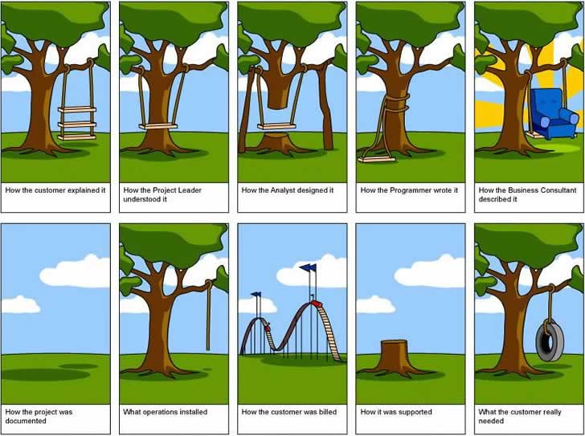
“Doing DCO”
Why we conduct Playback Sessions

Slide 21
Playback Sessions: Scrum
Informal and formal
Conduct informal “show and tells” as early as possible
Review application with the business to ensure that the team is headed in the right direction
Reduces risk of missed requirements and number of issues found in testing
Does not require a lot of preparation!
Host formal playback sessions at least weekly
Goal: get acceptance and conclude development on a set of specifications
Increases likelihood of acceptance by end users
Run the process in draft mode – OK to use dummy data

Slide 22
Playback Sessions: Scrum
Recommendations for success
Product Owner Acceptance
End of Sprint Demo
Use DCO: make changes directly into Pega in real- or near-real time to demonstrate how quickly changes can be made
Manage change: At end of session, ask PO to affirm that he/she accepts the story
Set the context for stakeholders by connecting the content to the overall business process or the iteration’s scope
Demonstrate changes made since previous playbacks
Manage change: Set expectations for attendees re: how stakeholders should provide feedback, and how the PO will prioritize it
The team only takes action on priorities set by the PO – they do not necessarily address all stakeholder feedback

Slide 23
Sample Sprint Calendar
The rhythm of a three week sprint
Sun | Mon | Tues | Wed | Thurs | Fri | Sat
 | 1 Sprint planning | 2 | 3 | 4 | 5 | 6
7 | 8 | 9 | 10 | 11 | 12 | 13
14 | 15 | 16 | 17 | 18 | 19 Review & Retrospective | 20
Daily stand-up
Playback
Scrum of Scrums
PO acceptance

Slide 24
Open discussion

Slide 25
DCO Topic Schedule Sample

Slide 26
DCO Planning Objectives
Used for planning DCO sessions with specific User Stories and processes
Helps the Client have visibility into what is planned to help ensure the right stakeholders are invited to the appropriate sessions
Plan prepared by the Pega LBA in consulting with the EL, and communicated to the entire team to increase transparency

Slide 27
SAMPLE- WorkBench Sliver 1A Inception DCO Week 1 & 2 At a Glance

Slide 28
WorkBench Sliver 1A Inception DCO Week 3 At a Glance

Slide 29
WorkBench Sliver 1A Elaboration DCO Week 1 & 2 At a Glance

Slide 30
WorkBench Sliver 1A Elaboration DCO Week 3 At a Glance

Slide 31
WorkBench Sliver 1A Elaboration DCO Week 3 At a Glance

