Slide 1
Defect Management Process
01 November 2017

Slide 2
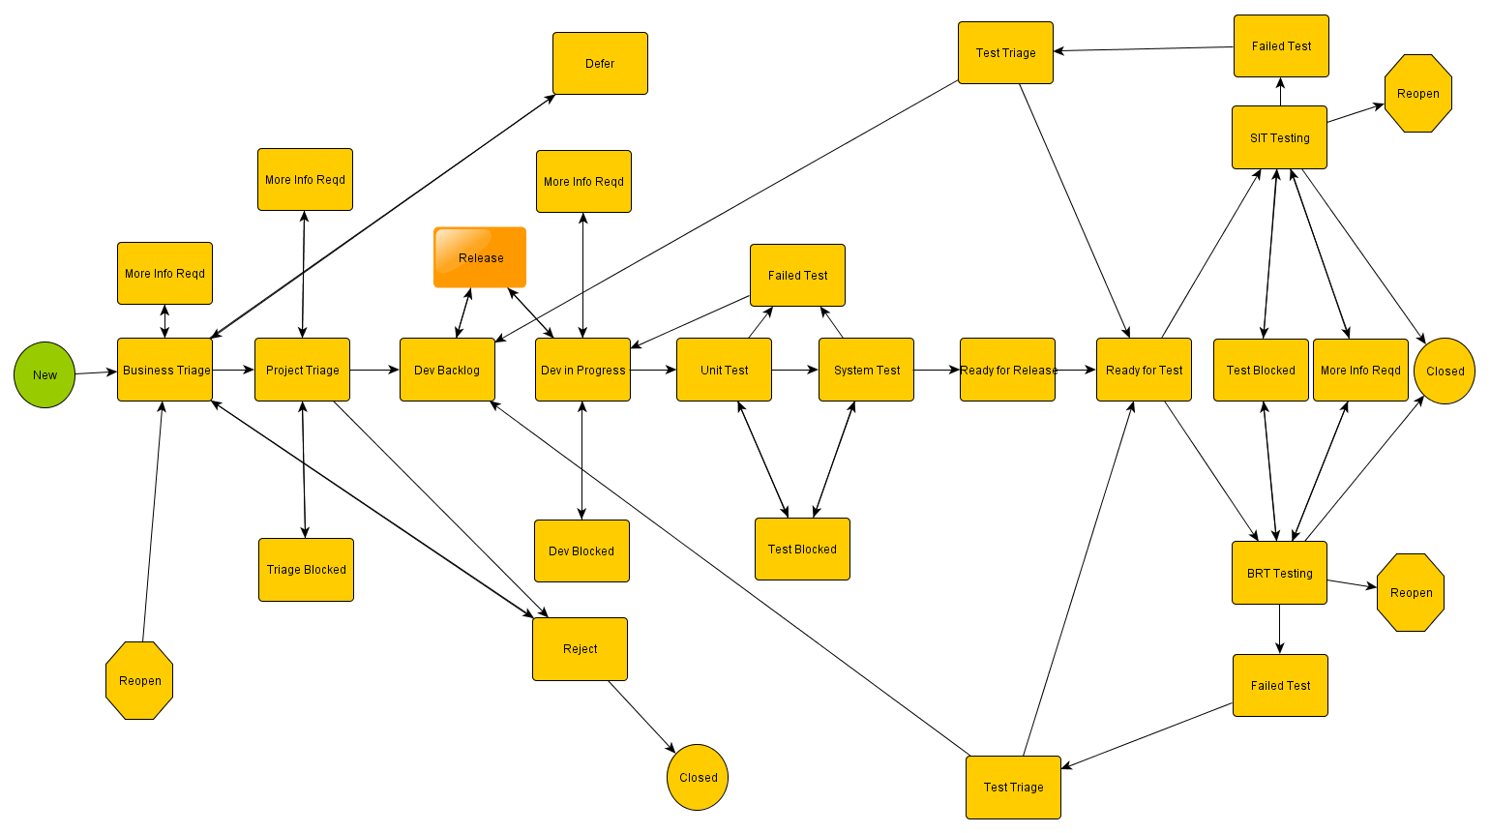
Proposed New Defect Process

Slide 3
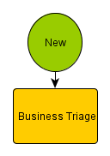
New Defects
New Defects will have a Status of New until Triaged by the Business
Suggested SLA – 1 Day for Severity 1 or 2

Slide 4
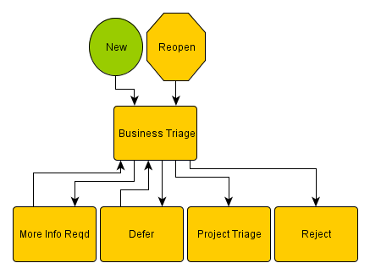
Business Triage
Business Triage will determine the validity of the defect and should try to determine the product affected and verify the severity
Defects Can Enter Business Triage from
New Defects
Reopened Defects
Reviews of Deferred Defects

Slide 5
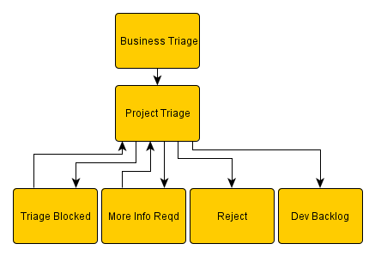
Project Triage
Project Triage will attempt to validate the defect and add to the Development Backlog
Project Triage should occur within 24 hours
Project Triage Can Reject Defects but not Close

Slide 6
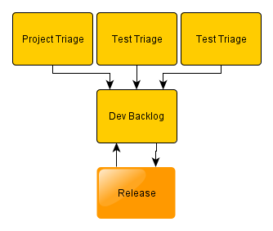
Dev Backlog
The Dev Backlog contains all the accepted Defects against the Product
The Dev Backlog can be fed from Project Triage or from Test Triage
The Backlog Items will be grouped into Releases

Slide 7
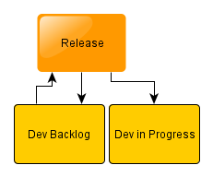
Releases
Releases will be made up of Defects grouped from the Dev Backlog to target a Release to SIT
Defects Added Must have the ETA Release date aligned to the Release
Developers will select Defects to fix from the Release Group

Slide 8
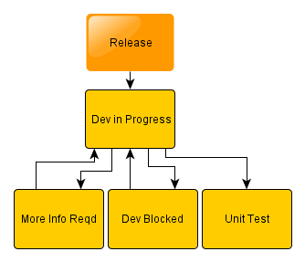
Dev In Progress
Developers will take a Defect from the Release Group and change the status to Dev In Progress
Developers Can Move to More Info Reqd or Dev Blocked
Once the Defect has been completed the Developer will move to Unit Test
Developers should record time spent fixing in Test Tracking Tool

Slide 9
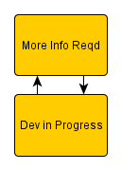
More Info Required
If more information is Required by the developer to fix the defect they will change the Status to More Info Reqd and Assign to the relevant Person
More Info Reqd Should be responded to in 24 Hours
Once the query has been answered it should be returned to Dev In Progress and Reassigned back to the Developer

Slide 10
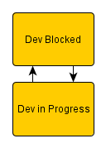
Development Blocked
If the developer is Blocked by another system or process they will change the Dev Blocked and a comment added in Test Tracking Tool to reflect the reason
The Defect should be assigned to the EL / PM to assist unblocking
Blockers will be reported every 24 Hours
Once the defect has been Unblocked it should be returned to Dev In Progress and Reassigned back to the Developer

Slide 11
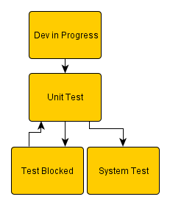
Unit Test
Once the Developer has fixed the Defect the status will be changed to Unit Test
Test Evidence must be uploaded
If the Defect Fails it will return to Dev in Progress
If the Defect Passes it will move to System Test
A Test can be Blocked with the same process as Development Blocked

Slide 12
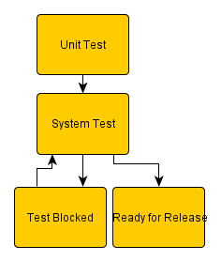
System Test
Once the Developer has passed Unit Test the status will be changed to System Test
Test Evidence must be uploaded
If the Defect Fails it will return to Dev in Progress
If the Defect Passes it will move to Ready for Release
A Test can be Blocked with the same process as Development Blocked

Slide 13
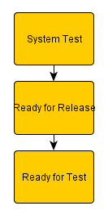
Ready for Release
When a Defect has passed System Tester it will be changed to Ready for Release
The Release Manager will add Details to Release Notes
A draft version should be distributed 24 hours in advance of Release
The Release Manager will change the Status to Ready for Test when the Release Package is delivered to Client Deployment Team
The Assignee should be changed to Client Test Tracking Tool Manager

Slide 14
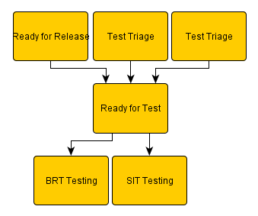
Ready for Test
The Ready for Test status will be set either from a Release Package or a Failed Test which has been rejected.
The Release should be deployed by Client Deployment Team
Once a SIT Tester take the Defect for Testing, the Status should be changed to SIT Testing and Assigned to the Tester
Once a BRT Tester take the Defect for Testing, the Status should be changed to BRT Testing and Assigned to the Tester

Slide 15
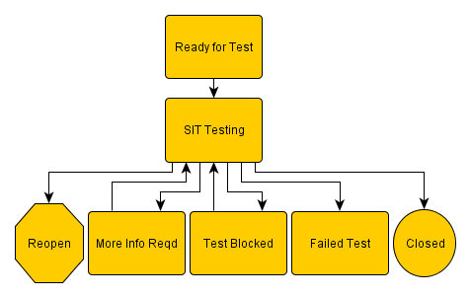
SIT Testing
Once a SIT Tester take the Defect for Testing, the Status should be changed to SIT Testing and Assigned to the Tester
If a Test is failed it should have the Status changed to Failed Test and Test Evidence uploaded. The Defect should be assigned to the Product EL / PM
A Test can be Blocked with a similar process to Development Blocked but stay assigned to the Tester
If more information is Required by the Tester to test the defect they will change the Status to More Info Reqd and Assign to the relevant Person
If the Test passes it should have the Status changed to Closed

Slide 16
BRT Testing
Once a BRT Tester take the Defect for Testing, the Status should be changed to BRT Testing and Assigned to the Tester
If a Test is failed it should have the Status changed to Failed Test and Test Evidence uploaded. The Defect should be assigned to the Product EL / PM
A Test can be Blocked with a similar process to Development Blocked but stay assigned to the Tester
If more information is Required by the Tester to test the defect they will change the Status to More Info Reqd and Assign to the relevant Person
If the Test passes it should have the Status changed to Closed

Slide 17
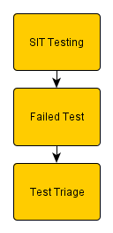
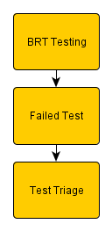
Failed Test
If a Test is failed it should have the Status changed to Failed Test and Test Evidence uploaded. The Defect should be assigned to the Product EL / PM

Slide 18
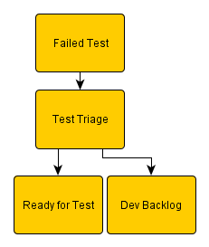
Test Triage
When a Defect Test has failed the EL / PM will assign the Defect to the nominated triager and change the Status to Test Triage
The Defect will be triaged and if accepted the Status will be changed to Dev Backlog
If the Defect failure is Rejected it will be assigned back to Ready for Test with Test Tracking Tool Updated with the Reason for Rejection
The Defect should be assigned back to the original tester

Slide 19
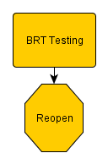
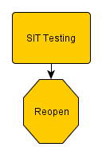
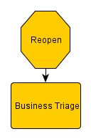
Reopen
A Defect can be Reopened by Test and the Status should be set as Reopen
The Assignee should be set to Client Test Tracking Tool Manager
Reopened Defects must go to Business Triage and follow the process through.

Slide 20
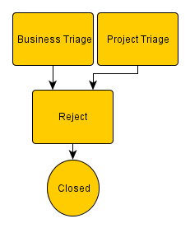
Reject
Rejected Defects should be reviewed by Client Test Tracking Tool Manager before being set to Close
If there is a doubt of Rejection the status should be set to Business Triage for Review

Slide 21
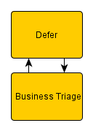
Defer
Defects which are Deferred are still open but not prioritised to be worked on
Only Business Triage should Defer a defect
Regular reviews should be undertaken by Client of Deferred Defects

Slide 22
Responsibility Matrix
Stage | Meaning | Owner | Action | SLA
New | New Defect Raised | User who raised the defect | Users must attach steps to recreate in Test Tracking Tool | N/A
Business Triage | Business to review defect | Client Defect Manager | Business to review and prioritise defects | Sev 1 or 2 – 1 Day
Project Triage | Project to validate defect | Project Triage Manager | Project Triage to validate and HL Estimate | 1 Day
Dev Backlog | Triaged Defects to work on | Project Triage Manager | Defects will be added to Releases | N/A
Dev In Progress | Defects actively in fix progress | Project Developer | Developer will select Defect from Release | N/A
Unit Test | Developer Testing | Project Developer | Developer to test and provide test evidence | N/A
System Test | System Testing | Project Test Manager | Project Testing and Provide evidence | N/A
Ready for Release | Ready for Deployment | Project Deployment Manager | Defects will be managed for release to Client in Releases | N/A
Ready for Test | Deployed to Client Test | Client Defect Manager | Client Deployment Team deploy to Client Test Environments | N/A
SIT Testing | In SIT Testing | Client SIT Tester | SIT Tester selects defect from Release to Test | N/A
BRT Testing | In BRT Testing | Client BRT Tester | BRT Tester selects defect from Release to Test | N/A
Failed Test | Test Failure Triage | Project Triage Manager | Project Triage to Validate and reallocate | 1 Day
More Info Reqd | More Information needed | Provider of Information | Sent to someone for more information to complete task | 1 Day
Blocker | Activity Blocked | Project PM/EL or Client Tester | Task Blocked and to be managed by PM/EL or Tester | Reported Daily
Reopen | Defect Reopened | Client Defect Manager | Closed Defects which are reopened go to Business Triage | Sev 1 or 2 – 1 Day
Defer | Defect not Prioritised | Client Defect Manager | To be reviewed on a regular basis by the business | N/A

